Slide 1
Medico
Submitted by,
Naresh Agarwal
Nidhi Goyal
Prathamesh Limaye
Priyank Gala

Slide 2



Project TIMELINE
RESEARCH ABOUT THE PROJECT
Development Phase
EXPERIMENTATION

Slide 3

Project TIMELINE
DATABASE Creation
TESTING The code
RESULTS Analysis
CONCLUSIONS

Slide 4
01
02
Objectives and Flow of the Project
03
Methodology
TABLE OF CONTENTS
04
Results Analysis
Conclusions
Introduction
05

Slide 5
Introduction
Time is lost between patients getting their body-part scanned, having their images analyzed by doctors, and scheduling a follow-up appointment. We propose a system to process images in real-time and allow people to seek & manage the treatment system.
The need for a comprehensive and automated method of disease screening has long been recognized, and there have been previous efforts for image classification, pattern recognition, and machine learning.
With photos of different types of scans as input, the goal of this capstone is to create a new model, ideally resulting in realistic clinical potential.
Scope
We propose a system to identify the scan type and the body type and extract relevant text from the scan. This system provides a base for the future expansions.

Slide 6
01
Objectives
Our aim of the project is to identify the image type and body type of the medical images. The best way to classify the images according to any type is using machine learning classification models.
Our next objective is to identify the text written on the medical image, to get an information such body alignment, image attributes etc. For image analysis, we have used python library OpenCV and with that for Text detection and extraction purpose, we have used EAST Text detection algorithm.
Next objective is to design and implement a MySQL relational database management system that holds user details including the image type and body parts they search.

Slide 7
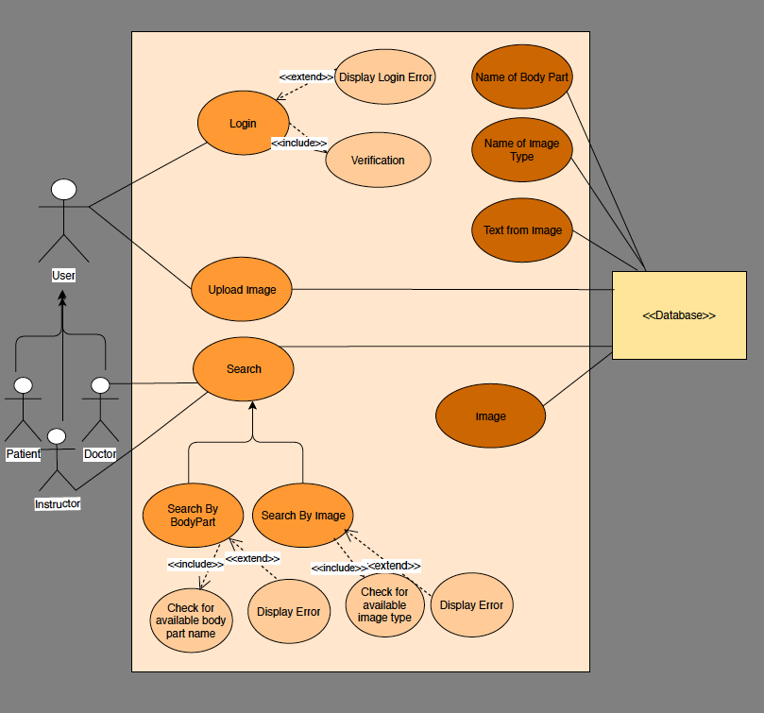
Use Case Diagram

Slide 8
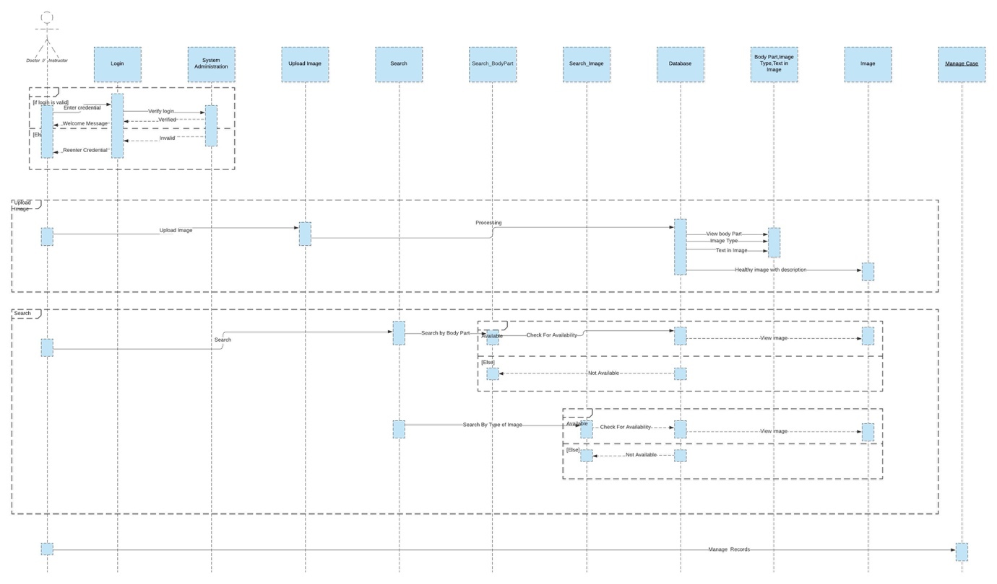
SEQUENCE DIAGRAM-1

Slide 9
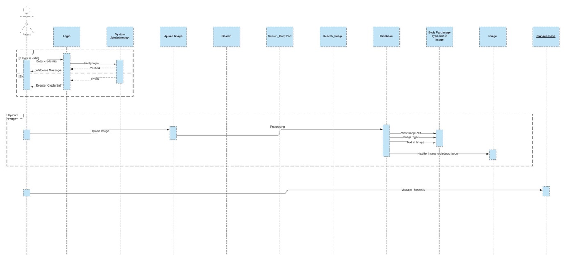
SEQUENCE DIAGRAM-2

Slide 10
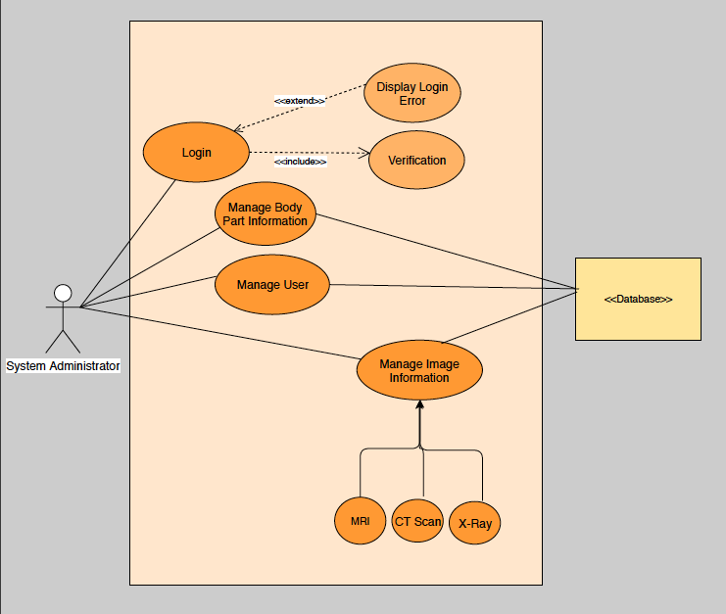
Use Case Diagram

Slide 11
02
Methodology
Preprocessing the data
Choose the Machine Learning classification Model
Training the data
Testing the data
Detect and Extract Text
Database Design and implementation

Slide 12
02 - A
Machine Learning Classification model
Convolutional Neural Network (CNN) is a special architecture of artificial neural networks. The main goal of the image classification is to accept the input data with its class, then learn the image features and attributes, and at last determine the picture in the image. For this, image get passed through a series of such as Convolutional, nonlinear, pooling layers and fully connected layers and then generates output.
- The Convolutional Layer
- The Nonlinear Layer
- The Pooling Layer
- The Fully Connected Layer

Slide 13
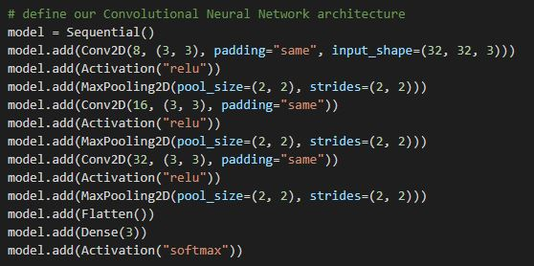
02 - A
Designing the CNN Model

Slide 14
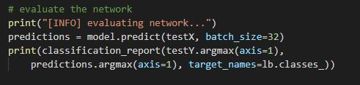
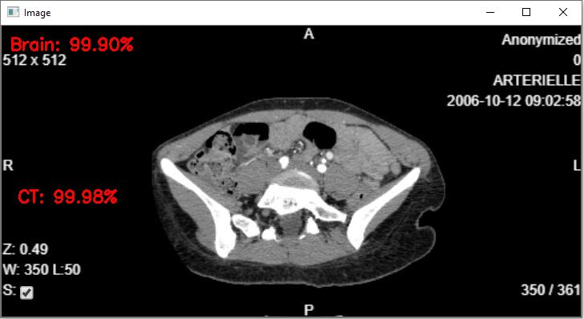
Testing of CNN Model
Results

Slide 15
02 - B
Text Detection and Extraction
Our next objective of the project is to identify the text written on the medical image, to get an information such body alignment,
image attributes etc. For image analysis, we have used python library OpenCV and with that for Text detection and extraction
purpose, we have used EAST Text detection algorithm.
Why we chose EAST detector?
Image/sensor noise: Sensor noise from a handheld camera is typically higher than that of a traditional scanner.
Viewing angles: Natural scene text can naturally have viewing angles that are not parallel to the text, making the text harder to
recognize.
Blurring and Lighting conditions
Resolution: Not all cameras are created equal — we may be dealing with cameras with sub-par resolution.
Unknown layout: We cannot use any a priori information to give our algorithms “clues” as to where the text resides.
OpenCV’s text detector implementation of EAST is quite robust, capable of localizing text even when it’s blurred, reflective, or
partially obscured

Slide 16
Steps
I: Import necessary packages
II: Text detection using EAST
IV: Text extract using LSTM
III: Extract score and geometry

Slide 17
Limitations and Drawbacks:
It’s important to understand that no OCR system is perfect!
There is no such thing as a perfect OCR engine, especially in real-world conditions. And furthermore, expecting 100% accurate Optical Character Recognition is simply unrealistic.
As we found out, our OpenCV OCR system worked in well in some images, it failed in others.
There are two primary reasons we will see our text recognition pipeline fail:
The text is skewed/rotated.
The font of the text itself is not like what the Tesseract model was trained on.

Slide 18
Process of Database Design
Conceptual Design:
Based on the requirements of the project with few attributes and relations
Platform independent i.e. irrespective of the technology, database management system version etc.
Logical Design:
Created document detailing all the information regarding entities, relationships between entities, keys, constraints etc.
Physical Design:
Represents the blueprint of a relational database
Represents data structure and relation in a specific database management system

Slide 19
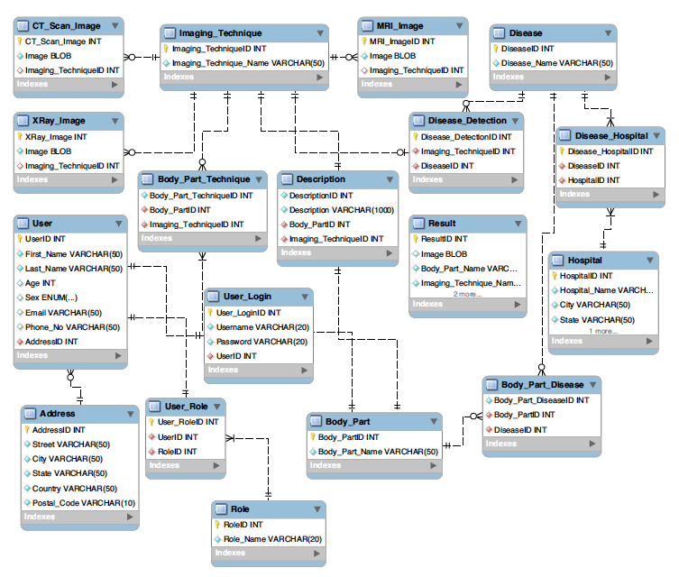
Entity Relationship Diagram

Slide 20
TRIGGER
The MySQL trigger is a database object that is associated with a table.
Activated automatically when a specified change operation is performed on a specified table
Why:
Used to check the integrity of data
Handle errors from the database layer
Give another way to run scheduled tasks
Useful for auditing the data changes in tables

Slide 21
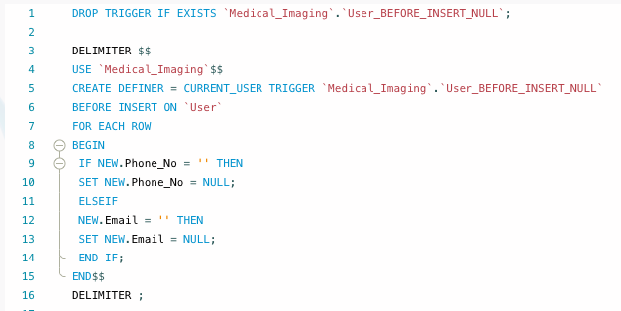
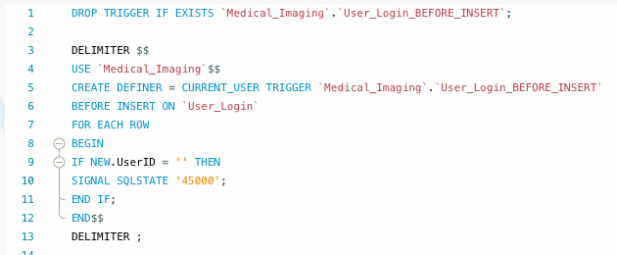
Before Insert and After Insert - the trigger is fired when data is inserted in the table. For Example:
User_BEFORE_INSERT_NULL
User_Login_BEFORE_INSERT
insert_user_vw (AFTER_INSERT_ON Trigger)

Slide 22
VIEW
MySQL view is simple select statement that gets the inner join result
View is always going to be up to date whenever we run the view statement
Why:
Hide complexity and Improves data security
Used as a security mechanism
Preserve the appearance of original table structure
Simplify data access and Reduce data distraction
Implements all queries

Slide 23
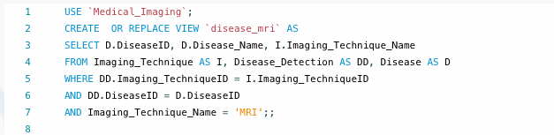
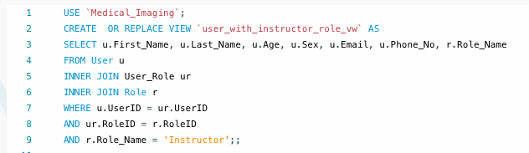
Views are:
user_with_instructor_role_vw
disease_mri
disease_ctscan
disease_xray

Slide 24
STORED PROCEDURE
MySQL stored procedure is an executable database object that contains one or more SQL statements
A procedure has a name, a parameter list, and SQL statements
Why:
Fast
Portable
Can restrict and control access to a database

Slide 25
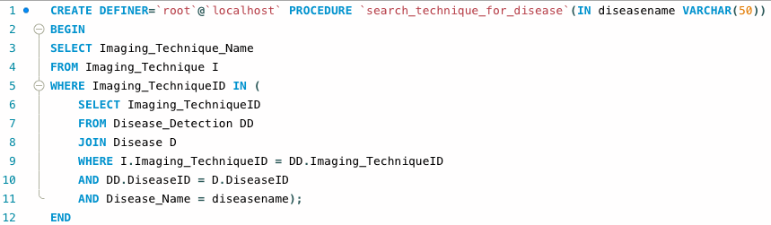
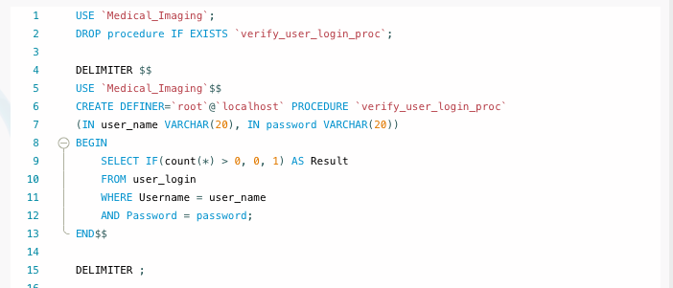
Stored Procedures are:
verify_user_login_proc
add_user
add_disease
add_body_part
add_imaging_technique
search_technique_for_disease

Slide 26
STORED FUNCTION
MySQL stored function is a set of SQL statements that perform some operation and return a single value
Why:

Slide 27
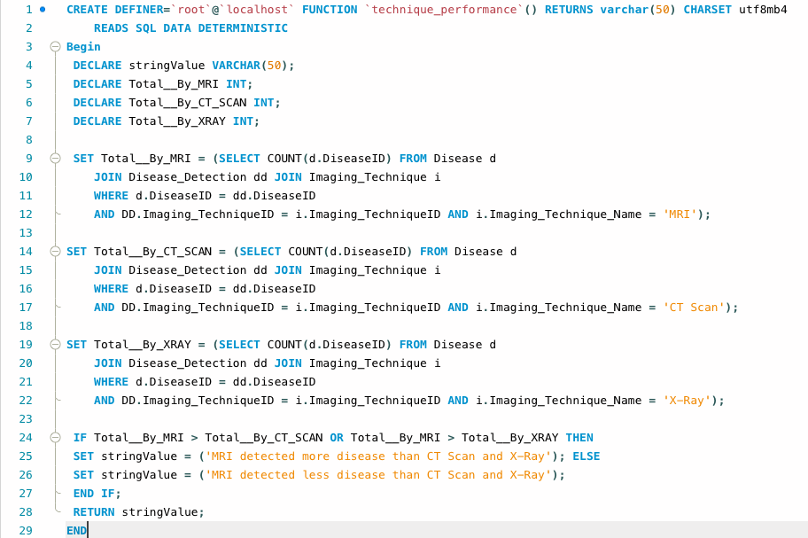
Stored Functions are:
technique_performance
body_part_max_image

Slide 28
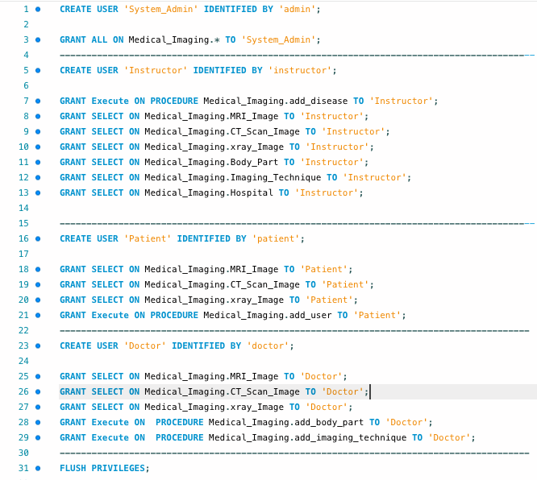
USER PRIVILEGE
In the Medical_Imaging database, we assigned four user -
System_Admin,
Instructor,
Patient,
Doctor

Slide 29
Future expansions
Expanding this model for other type scans (like PET scan,) and for different body parts.
Collaborating with a hospital to get accurate image dataset to train the model even better in-turn to provide a better health care facility
Enhancing the features of the proposed system to enable/ predict the type and severity of the disease by providing the image of the scan.
3D-modeling of the disease and treatment plan.

Slide 30
RESOURCES
https://www.tcts.fpms.ac.be/publications/regpapers/2007/VS_cmtbg2007.pdf
https://github.com/llSourcell/AI_in_Medicine_Clinical_Imaging_Classification#preprocessing
https://www.youtube.com/watch?v=mWl45NkFBOc

Slide 31
THANKS
DO YOU HAVE QUESTIONS?
Team: AssistBot

